Slide 1
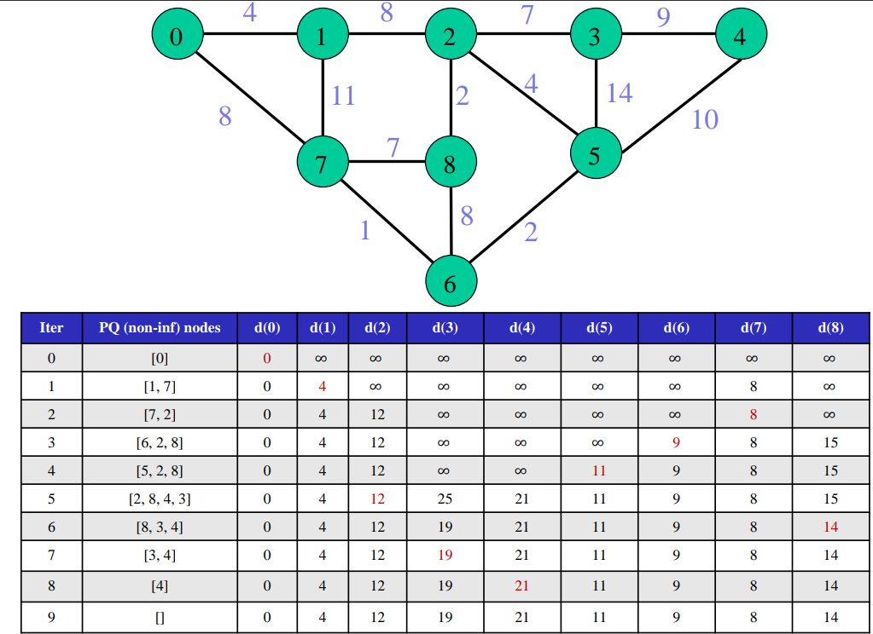
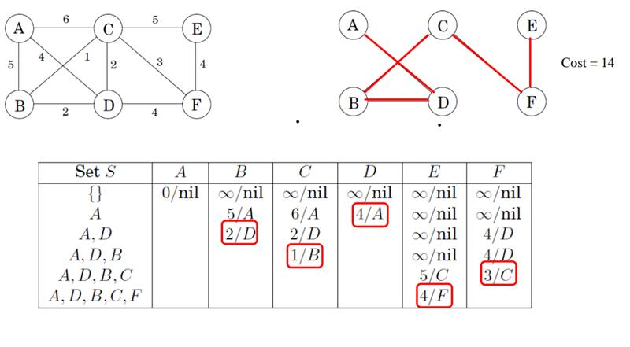
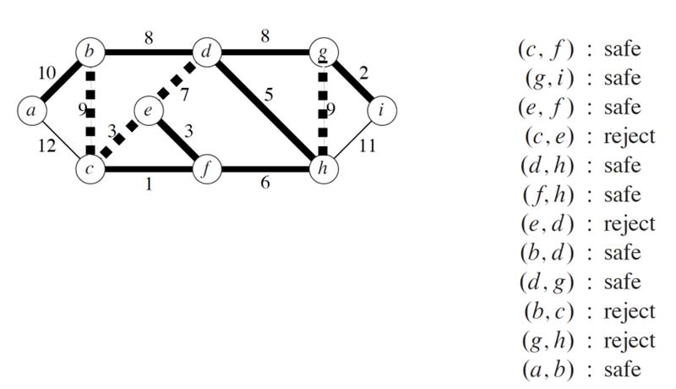
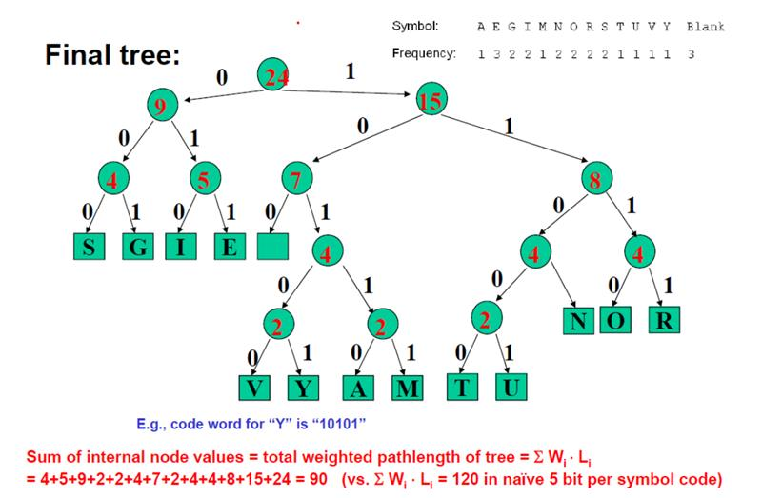
Greedy Algorithm: Sort weight/prob by xx in increasing order
Item​ |  | PQ​ | Running time​ | ​
Dijkstra 求源点到所有点的最短距离​ |  | Yes​ | (V+E)·logV​ | start to all calculate the shortest path​
Huffman prefix tree​ 二进制编码字母频次​ |  | Yes​ | n·logn​ | Sort by frequency in increasing order​ Full tree + left branch is 0 + right branch is 1​ Sort again because new node is added.​ Alphabet has 27 characters(26 letters and space)​
Mini Spanning Tree​ 求最小生成树​ | Prim:​ ​ | Yes​ | V·logV + E·logE​ | 按点选安全最小边​ Select the node randomly​ Choose the shortest edge every time. 选完点再把边sort​
 | Kruskal​ Union Find​ | Yes​ | E·logE+E​ | 最开始就需要sort所有边​ Select the shortest edge firstly，每次都选最小权重安全边​
Activity Selection​ 求最大子序列/最多活动​ |  | ​ | n·logn​ | Sort按照结束和开始时间都可以​ 重点识别最大的子序列(课程数量最多)，与收益价值无关。​
Interval Scheduling​ ​ |  | ​ | n·logn​ | Sort按照结束和开始时间都可以​ 重点是最少的教室数量安排所有的课程​

Slide 2
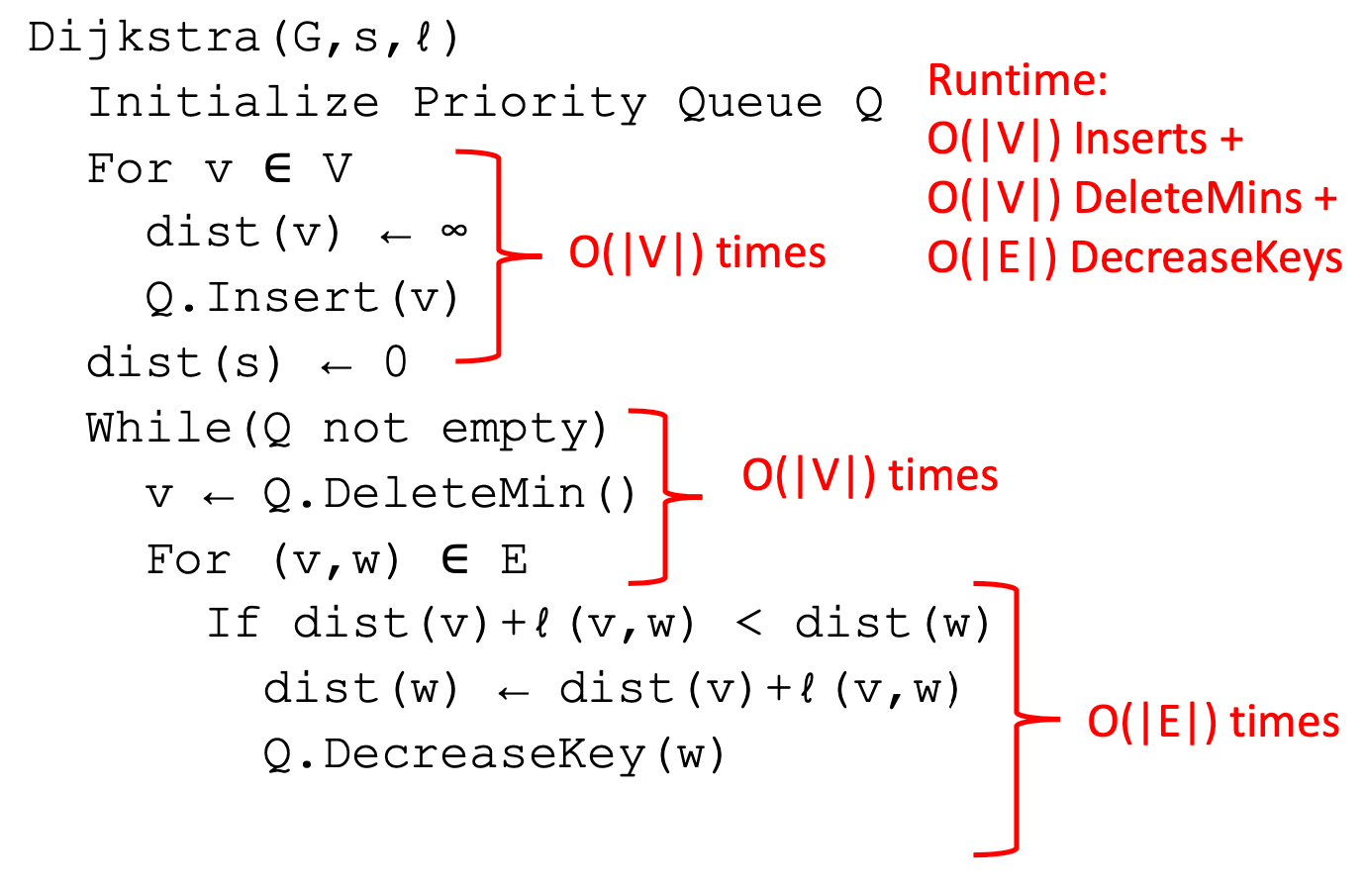
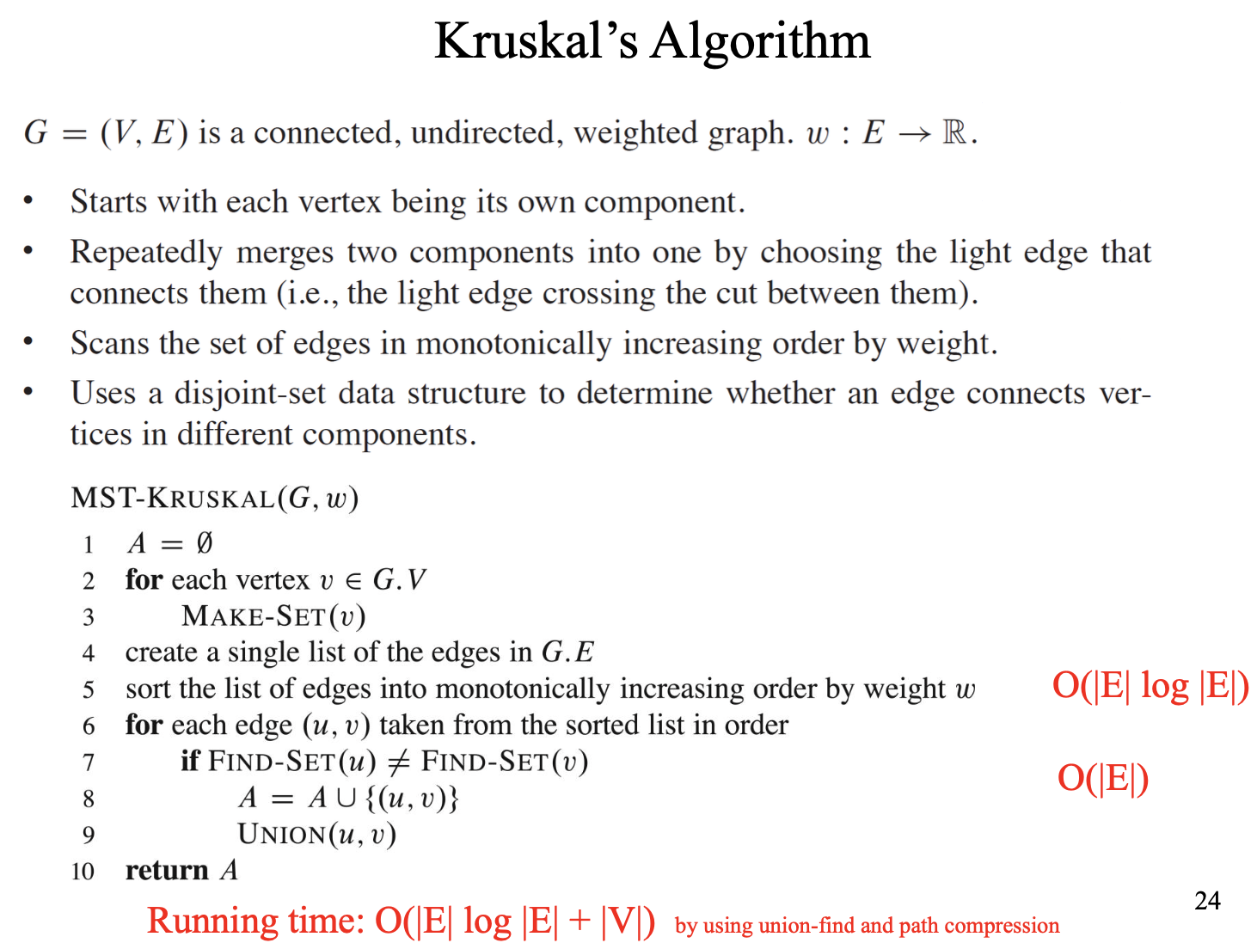
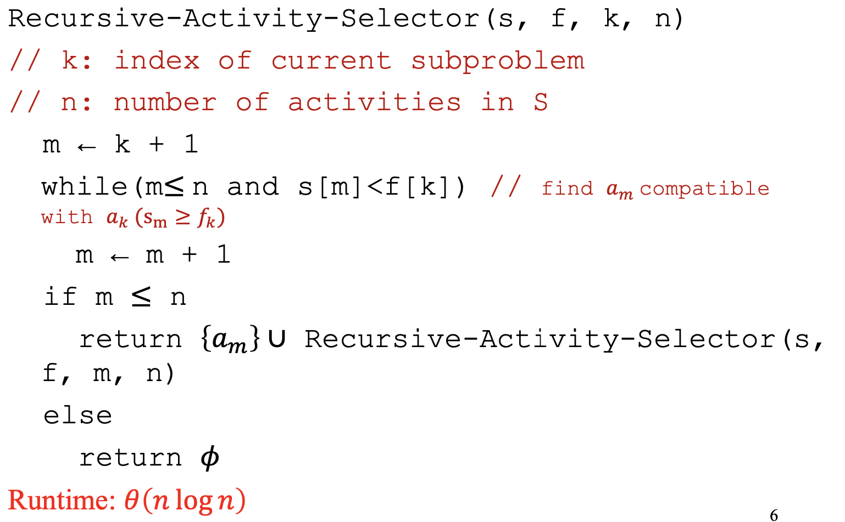
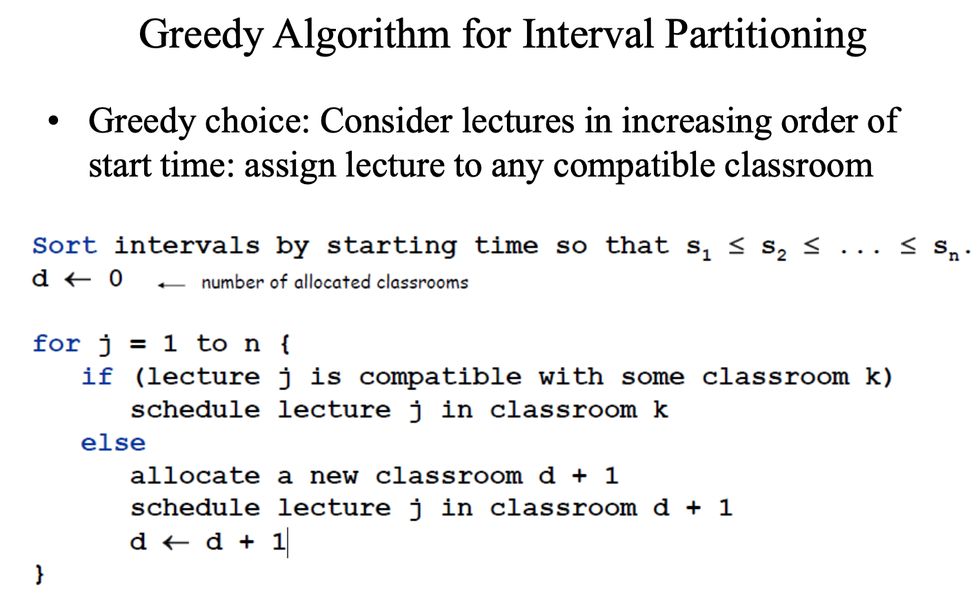
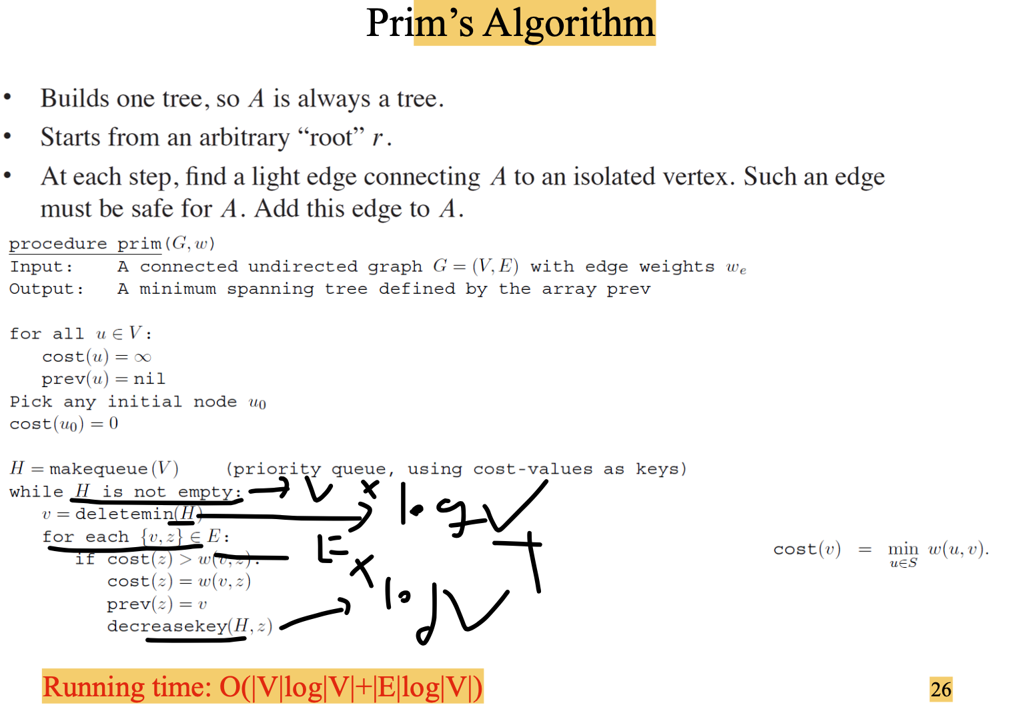
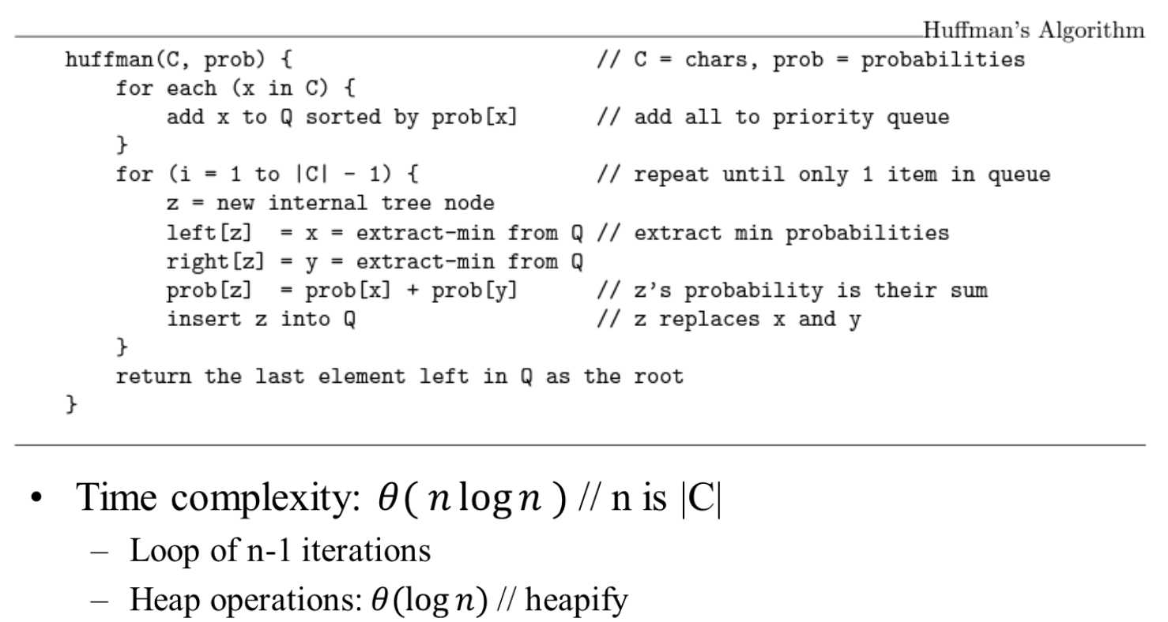
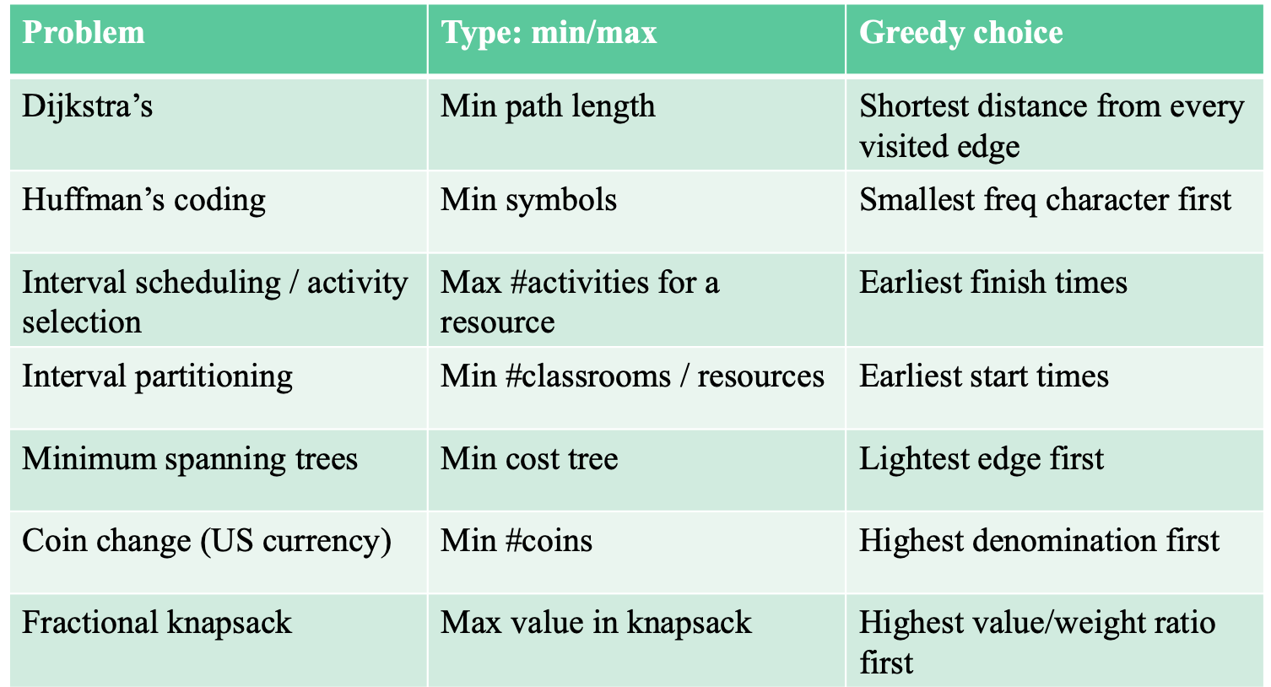
Total time: (V+E)logV
The algorithm begins by initializing distances of all nodes in the graph to +∞, and dist(s) = 0. where s in the source. When s has been removed from the PQ, distances to all adjacent nodes to s are still +∞. comparison dist(u) > dist(s) + l(s, u). so the comparison is true and dist(u) will be updated to dist(s) + l(s, u).

Slide 3
Dijkstra—一个点到所有点最短距离
 | Step | Code: s-start node; l- edge weight | time
 | PQ | Dij(G, s, l): Initialize PQ
 | Define infinite for all vertex | For v in V dist(v) == infinite Q.insert(v) dist(s) = 0 | V
 | Find the shortest path | While Q not empty: v = Q.pop() For (v, w) in G: If dist(v) + l(v,w) < dist(w): dist(w) = dist(v) + l(v,w) Q.append(w) | (V+E)logV

Slide 4
Prim—所有点连接的最短距离
 | Step | Code: s-start node; l- edge weight | time
 | 初始化将所有点为无穷大 | Prim(G, w): For v in V: cost(v) = infinite Prev(v) = nil pick any initial node as u cost(u) = 0 PQ.append(u) While PQ: v = PQ.pop() For each {u, z} in G[v]: If cost[z] > w(u,z) cost[z] = w(u,z) Prev(z) = u PQ.append(z) | 红色字体： VlogV
 | 任意选择一个点作为起点
 | 运用PQ逻辑每次对相邻最小的进行弹出
 | 将新发现的最小边的点加到PQ |  | 蓝色字体： ElogE

Slide 5
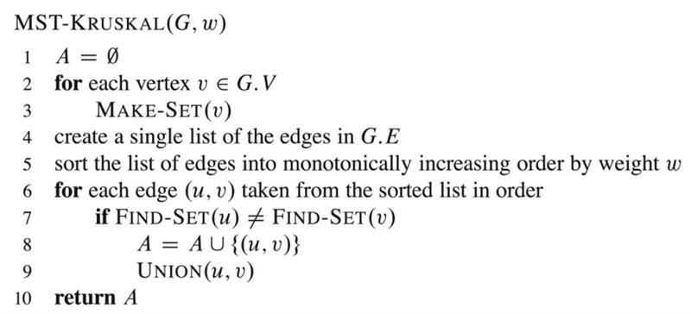
Kruskal—所有点连接的最短距离
 | Step | Code: s-start node; l- edge weight | time
 | 提取每个边的权重，然后增加到PQ |  | 第一部分时间复杂度最高为 ElogE
 | 从最小权重开始Loop
 | Union Find判断它们是否相同
 | 如果不相同将它们添加 |  | 第二部分就是边的比较 E

Slide 6
Huffman
 | Step | Code: | time
Place the elements into PQ | 1.Find to root nodes with smallest value 2.Create a new root node with two small nodes as children | Human(C, prob) For x in C: PQ.append(x) For i = 1 to len(C) -1: x = PQ.pop() y = PQ.pop() z = x + y PQ.append(z) Return PQ.pop() | 第一部分由于x 有n个，每次PQ为logn nlogn
Remove the first two elements
Combine 2 elements with root |  |  | nlogn
Combine 2 elements with root
Insert the new element into PQ
考点：
1.对应字母的code word
2.Total Weight
3. 画出这个图

Slide 7
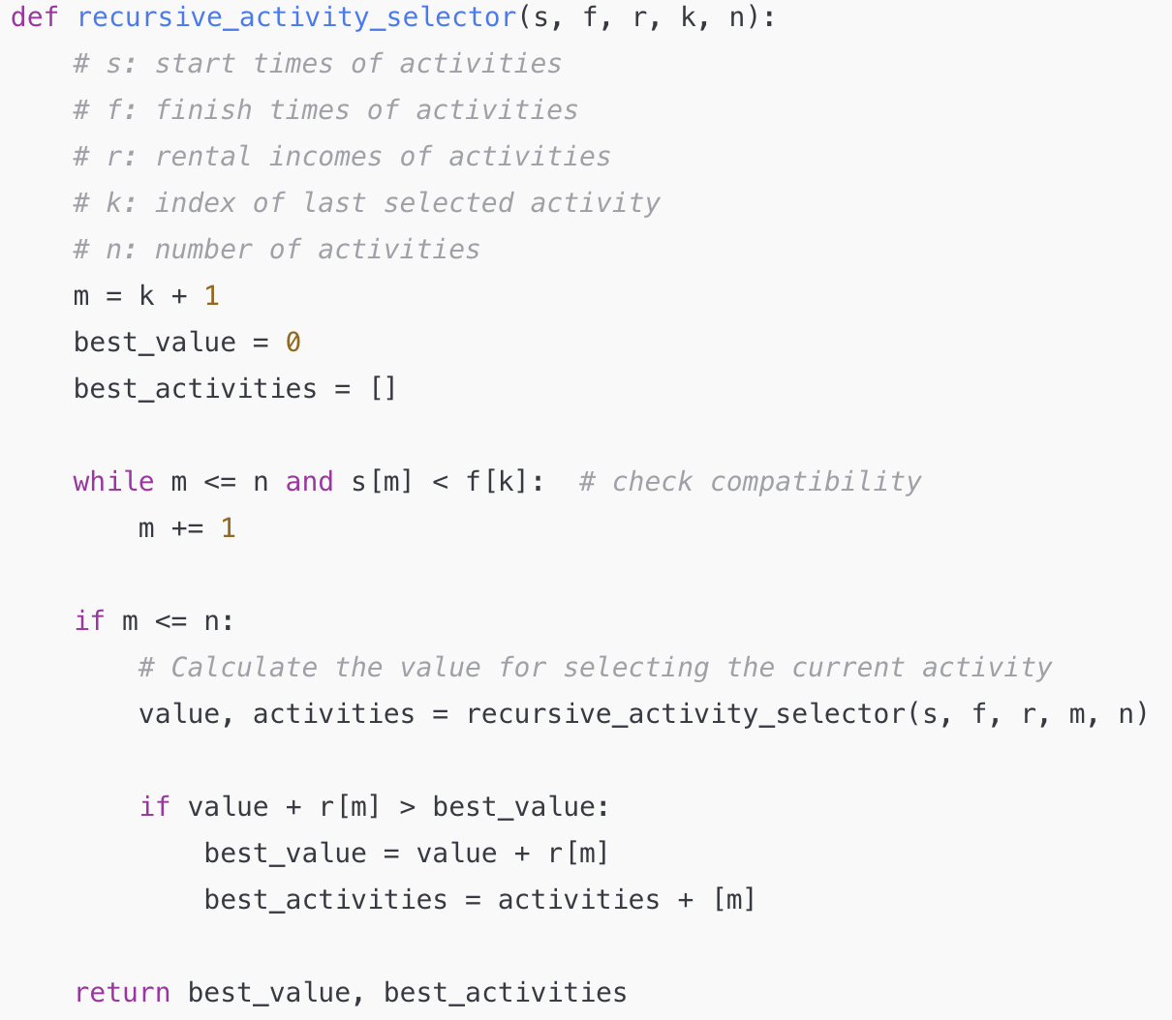
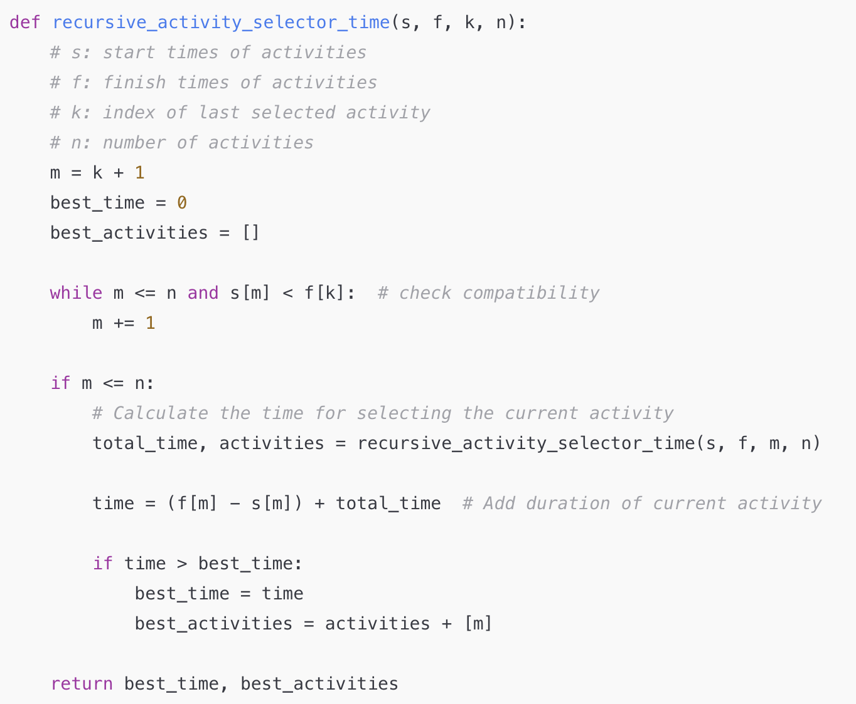
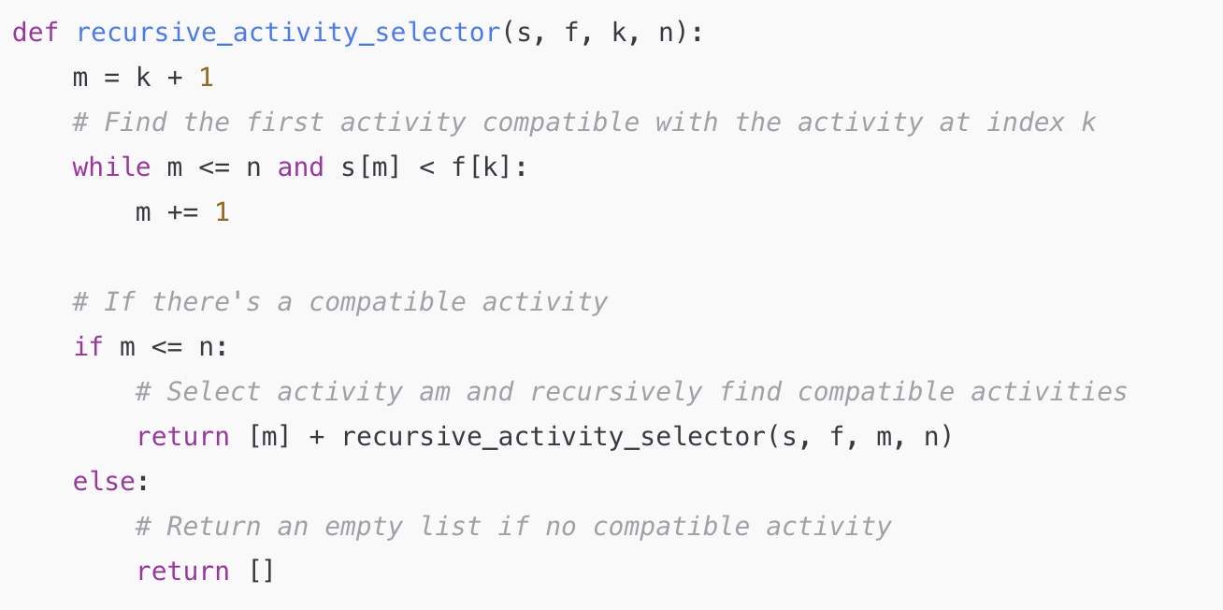
Activity Selection
Maximizing Rental Income
Maximizing longest time
当前Code延伸可以实现最大收益以及最大时间
最大的子序列

Slide 8
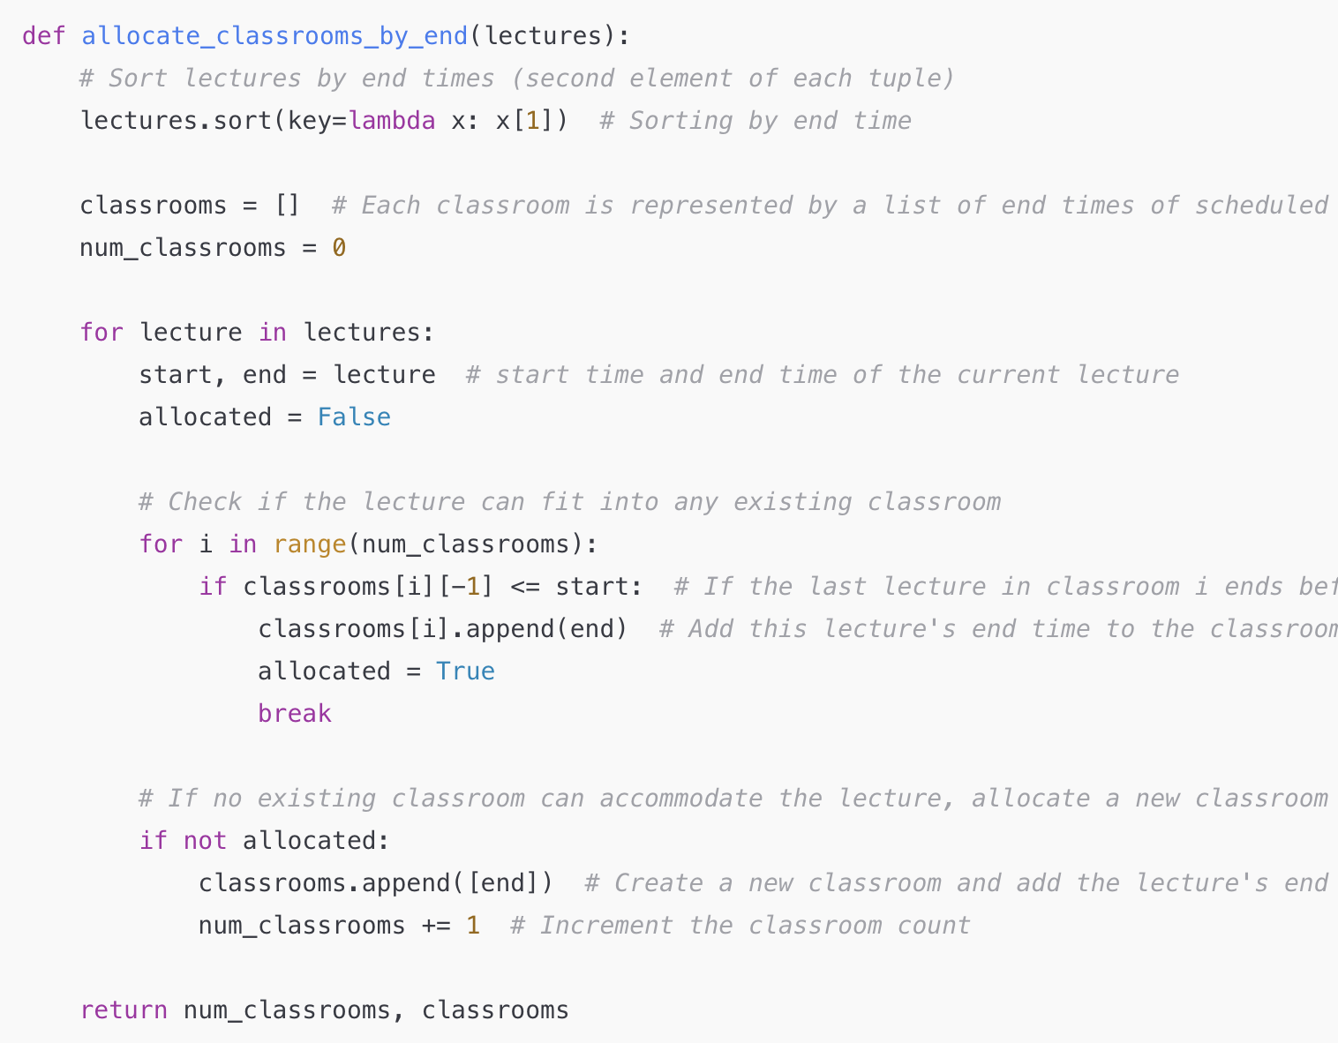
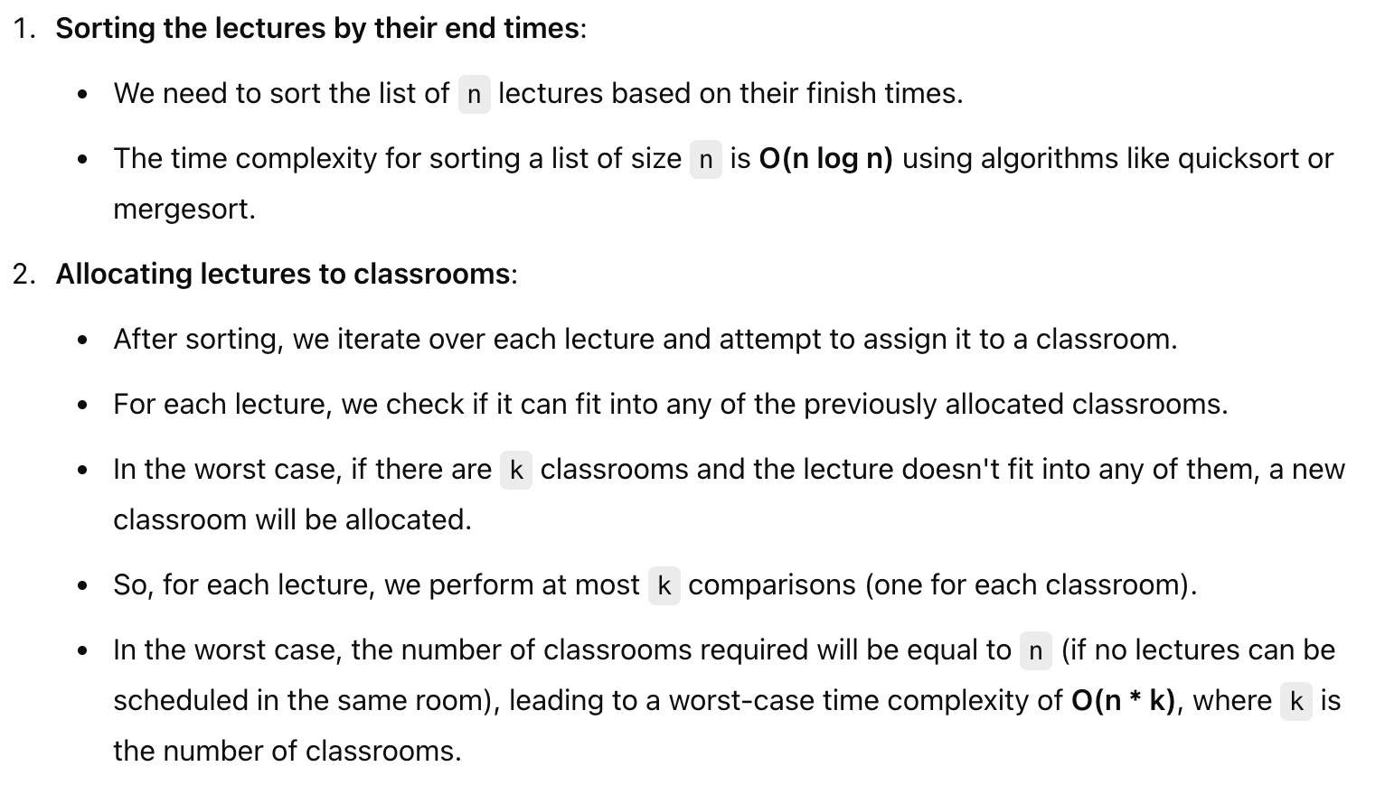
Interval Scheduling
教室 | End time
1
2
3
首先比较第一个教室的结束时间，逐渐递增比较

